Slide 1

讓重複、費時又無聊的工作自動化吧
Nick Huang 2021/03/29

Slide 2
Automation
CI / CD
Jenkins
Docker

Slide 3
Automation

Slide 4


Slide 5
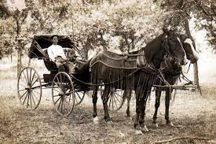
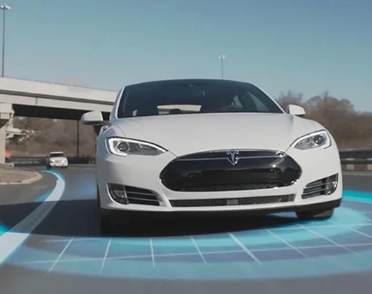
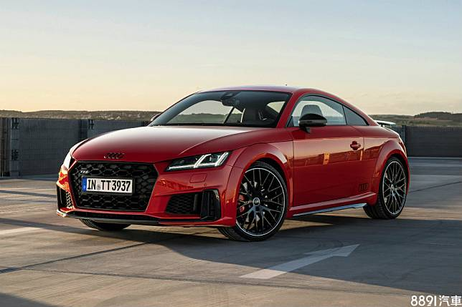

Slide 6
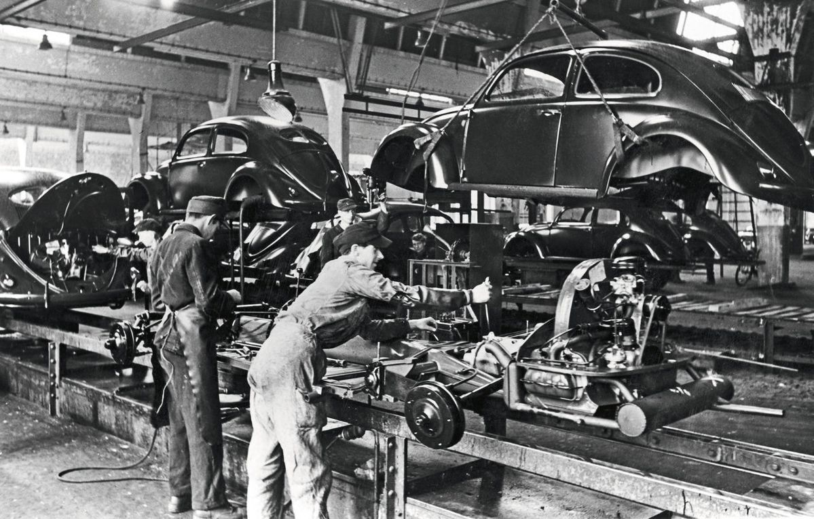
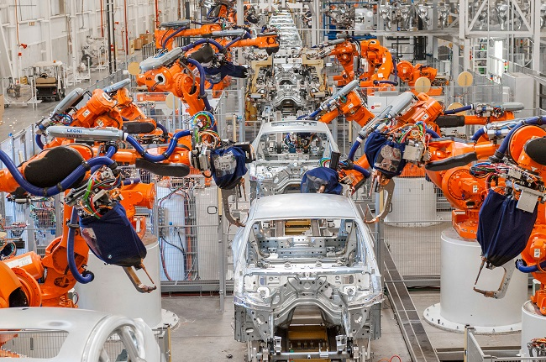

Slide 7
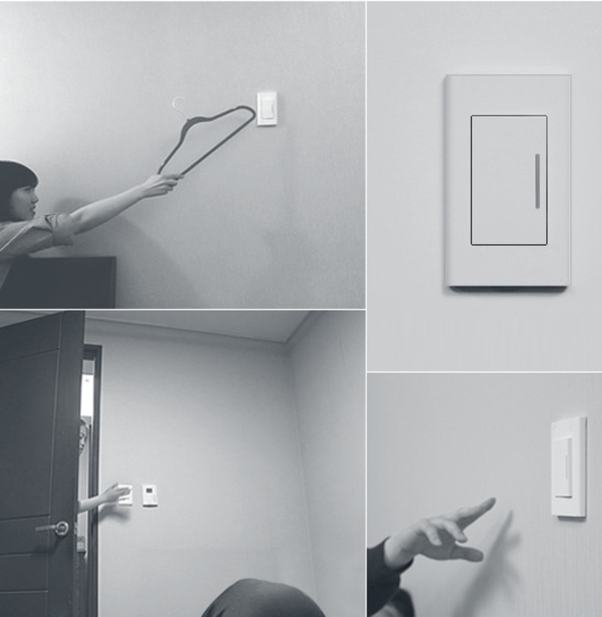
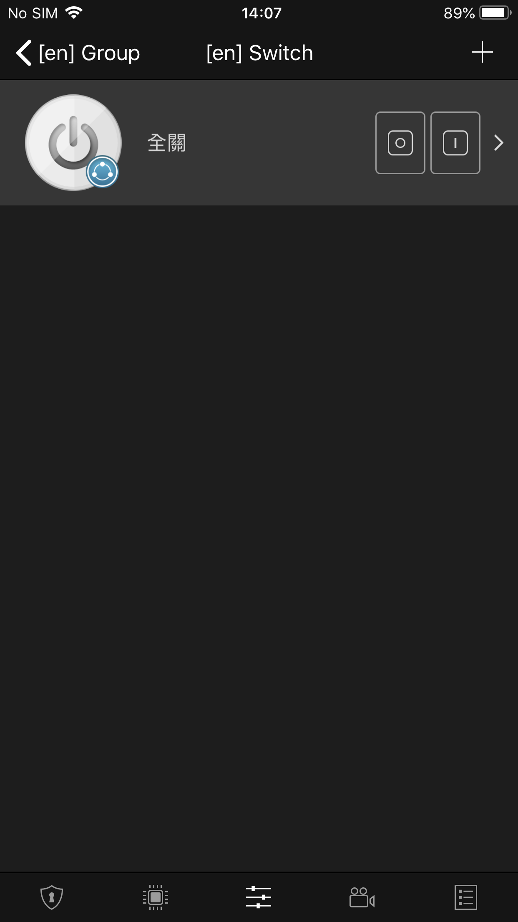

Slide 8

Build & Archive (xcodebuild / gradlew -> Jenkins)
Test (Unit test -> Jenkins)
Translation (Shell Script -> Jenkins)

Slide 9
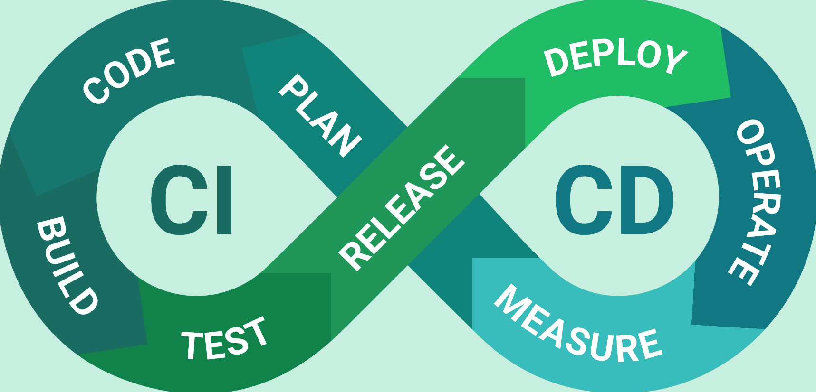

Slide 10
Continuous Integration
Continuous Deployment
Build & Archive
Unit Test
Release mail
Firebase
TestFlight
Google drive
App Store
Google play Store

Slide 11





https://github.com/apple/swift
https://github.com/Alamofire/Alamofire
https://github.com/pofat/DUFramework

Slide 12
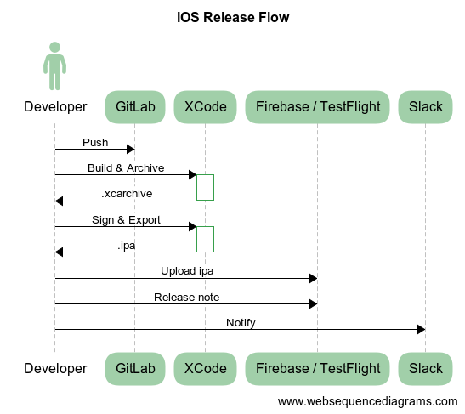

Slide 13
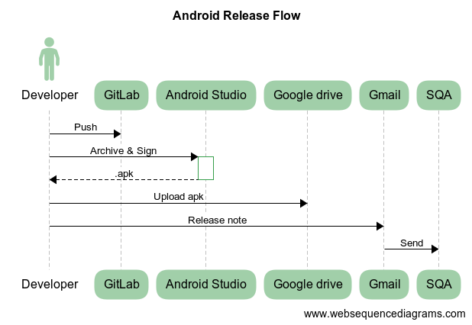

Slide 14
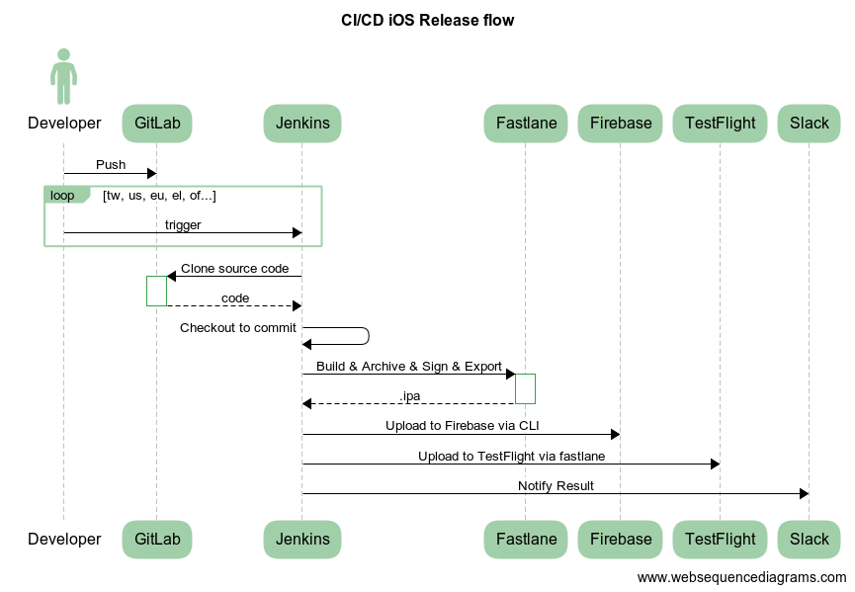

Slide 15
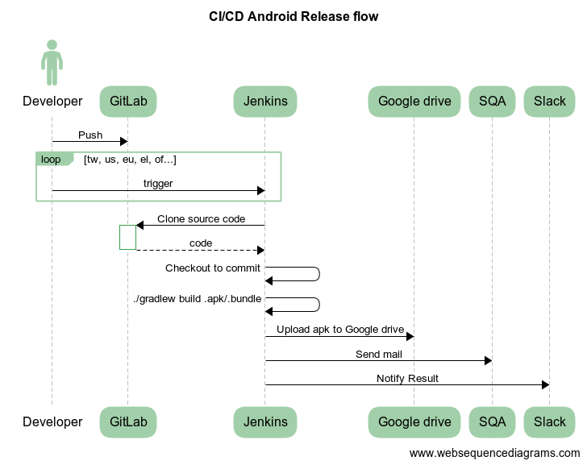

Slide 16
https://fastlane.tools/

Slide 17


Slide 18


Slide 19
虛擬機器 vs 容器
https://cwhu.medium.com/docker-tutorial-101-c3808b899ac6

Slide 20
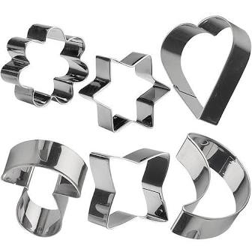
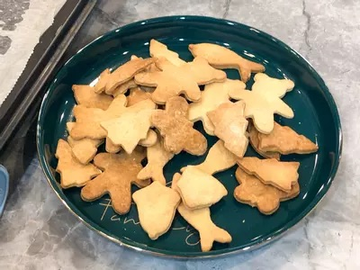
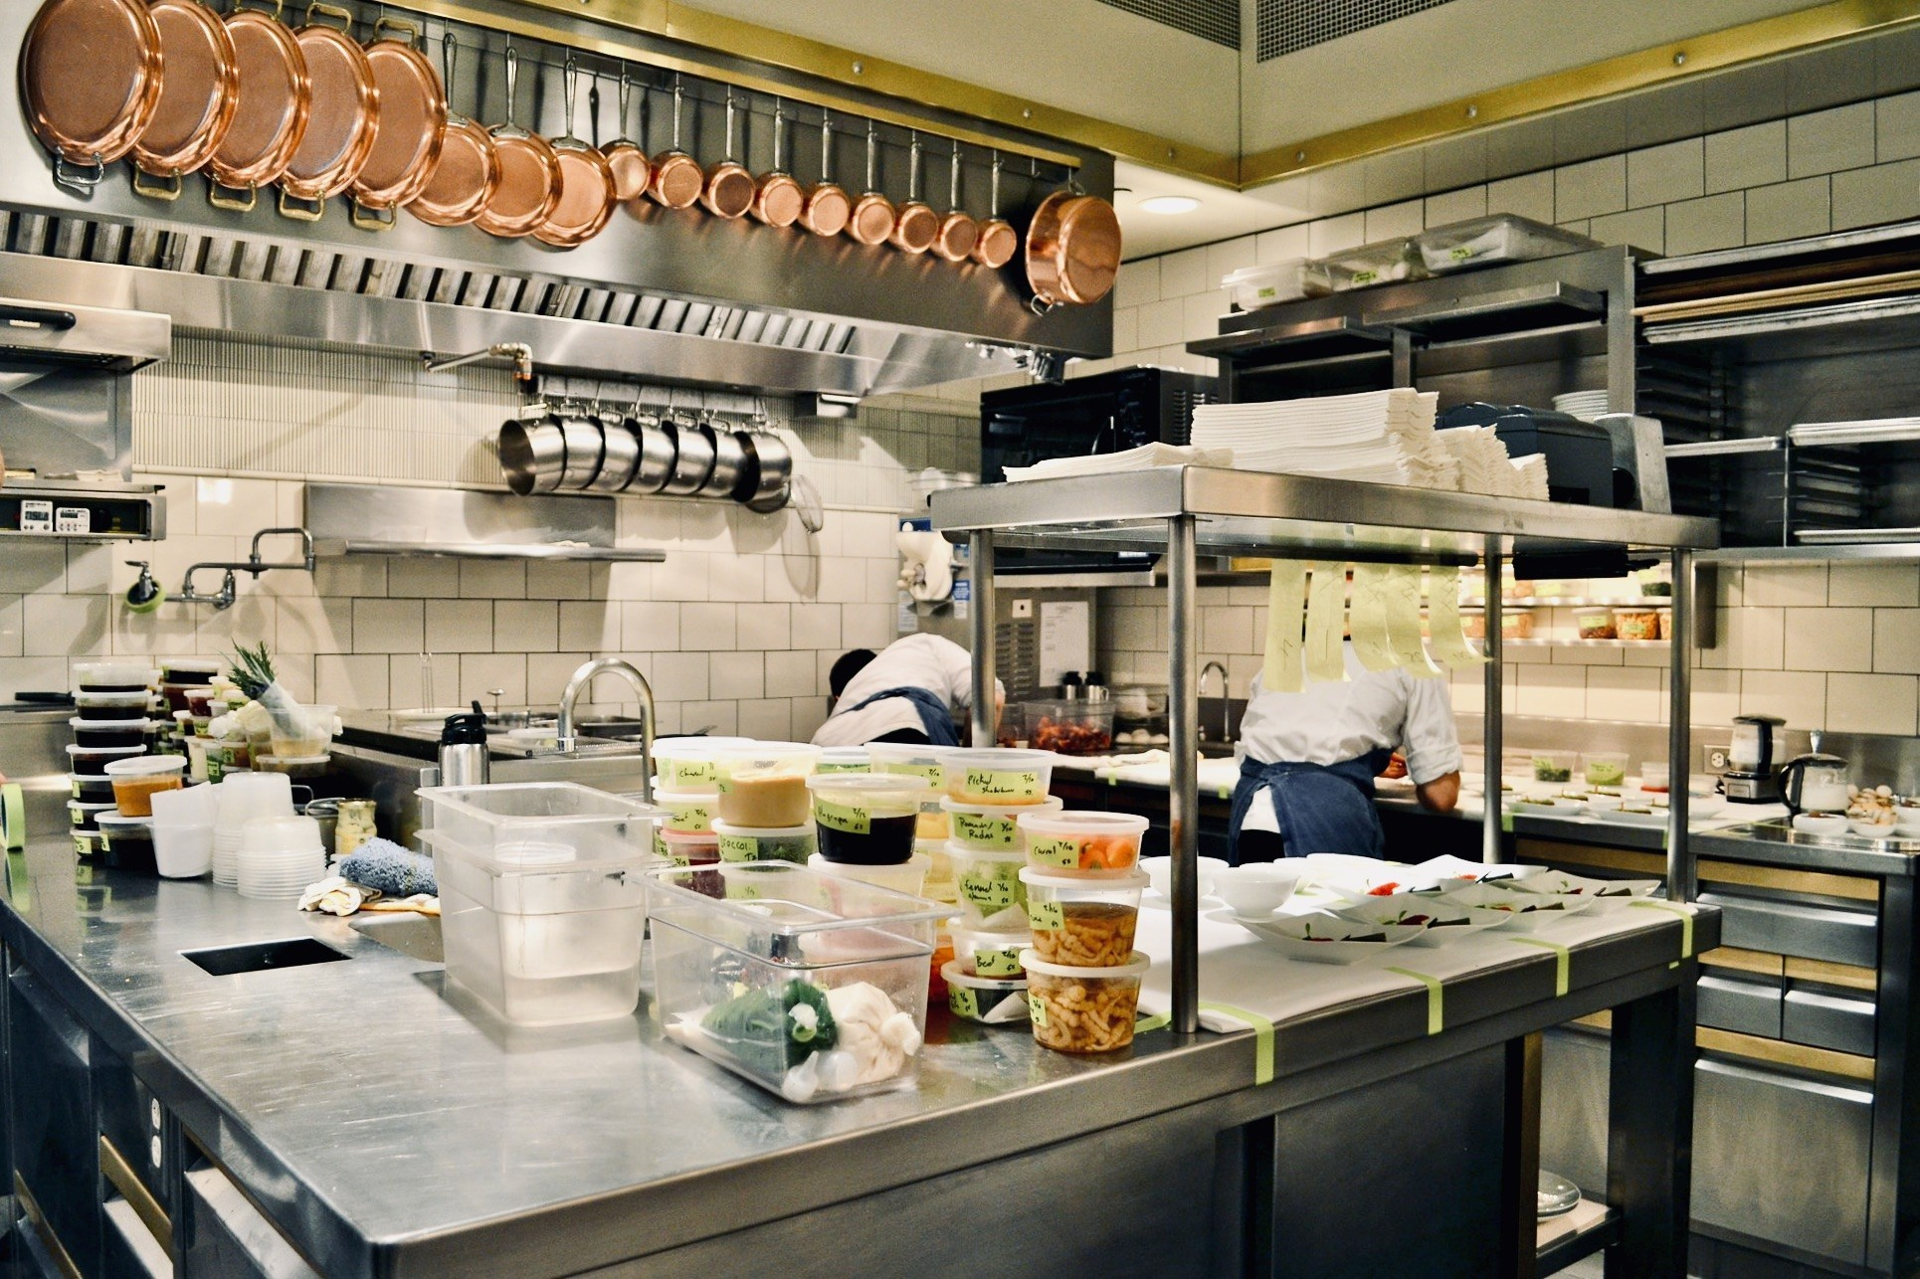



Docker 三大元素
Image
Container
Repository

Slide 21
Demo

